Slide 1
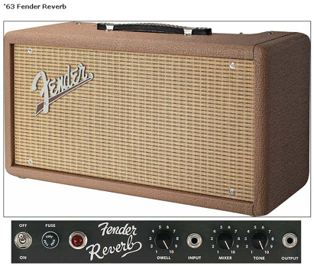
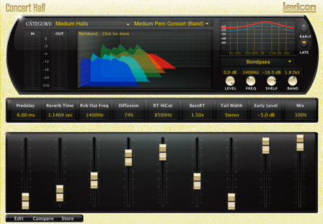
Convolution and Reverb in the Web Audio API

Slide 2
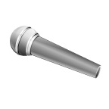

What is reverberation?
Series of delayed and attenuated sound waves
Result of many reflections within a space
Multiple paths from a source to our ears
Direct path
Strongest and first
Reflected paths, bouncing off walls or ceiling
Weaker and arrive later
Creates spaciousness of a room
Microphone
Source

Slide 3
Impulse response
Early
Reflections
Late
Reflections
Magnitude
Time
Series of scaled delta functions
Each vertical line marks when sound heard again
represents delayed, attenuated copy of sound
Height of lines represents how loud sound is at that time
What would simple feedback delay look like?

Slide 4
Why use reverb?
Why add artificial reverb to recorded sound?
Dry signals (e.g. close mic) sound unnatural
Compensate for non-reverberant listening environment
Headphones have no natural reverb
Car or small room might not have sufficient reverberance to recreate sound of orchestra in concert hall
Can add natural reverb by recording in large room
Distant microphones capture ambience as well as direct signal
Impractical in many situations
→ Add reverb synthetically

Slide 5

Convolution Reverb
Reverb can be completely characterised by its impulse response
Suppose we have impulse response of a room
Record impulse (like popping balloon) with microphone in one location, sound source in another location
Apply reverb by convolving signal with recorded impulse response
Makes it sound as if it is in the space

Slide 6

ConvolverNode
Convolution
ConvolverNode performs convolution on an AudioBuffer
Used to achieve a reverb effect
Always has exactly one input and one output
Properties
buffer - mono, stereo, or 4-channel AudioBuffer containing (possibly multichannel) impulse response used by ConvolverNode
normalize - boolean that controls whether impulse response will be scaled by an equal-power normalization. Default is true
Lets demonstrate convolution for short pulse convolved with simple one channel buffer

Slide 7
Setting up an audio buffer
AudioBuffer represents short audio asset in memory
typically less than 45 s
created from audio file using AudioContext.decodeAudioData() method, or from raw data using AudioContext.createBuffer().
Once put in an AudioBuffer, audio can be played by being passed into an AudioBufferSourceNode
For longer sounds, MediaElementAudioSourceNode is more suitable
Buffer contains data as arrays with values between -1 and +1
Lets create an impulse response (IR)
Here, decay >0 is the rate of decay
Impulse response can also come from a recording
function impulseResponse(duration,decay) {
var length = context.sampleRate * duration;
var impulse = context.createBuffer(1,length,context.sampleRate);
var IR = impulse.getChannelData(0);
for (var i=0;i<length;i++) IR[i] = (2*Math.random()-1)*Math.pow(1-i/length,decay);
return impulse;
}

Slide 8
Applying convolutional reverb
Lets create short sinusoidal pulse of 100 ms as our source
Connect an oscillator to a gain
Have the gain node’s gain parameter jump to 0 after 0.1 s
Create impulse response using function shown previously
Set that as the buffer of the convolver
Simply connect the pulse to the convolver
Compare this with the pulse without reverb
Connect amplitude (instead of convolver) to destination
var context = new AudioContext();
var source = new OscillatorNode(context,{type:’sine'});
source.start();
var amplitude = new GainNode(context);
amplitude.gain.setValueAtTime(0,context.currentTime+0.1);//pulse lasts 100 ms
var impulse=impulseResponse(1,2);//1 second impulse, with decay value 2
var convolver = new ConvolverNode(context,{buffer:impulse});
source.connect(amplitude);
amplitude.connect(convolver);
convolver.connect(context.destination );

Slide 9
Buffer[0]
Buffer[0]
Buffer[1]
Buffer[0]
Buffer[0]
Buffer[1]
Buffer[1]
Buffer[0]
Buffer[0]
Buffer[1]
Buffer[1]
Buffer[2]
Buffer[2]
Buffer[3]
Buffer[3]
Mono with mono response
‘mono’
Mono with stereo response
‘mono to stereo’
Mono with stereo matrix response
Stereo with mono response
Stereo with ‘true’ stereo matrix response
‘true stereo’
Stereo with stereo matrix response
‘normal stereo’
Notes:
single channel convolution operates on a mono audio input, using a mono impulse response, and generating a mono output. 1->1
Then mono to stereo 1-2
Stereo to mono 2->1
The remaining images illustrate the cases for mono and stereo playback where the number of input channels is 1 or 2, and the number of channels in the buffer is 1, 2, or 4. If you want other matrixing options, you can use the ChannelSplitterNode, multiple single-channel ConvolverNodes and then a ChannelMergerNode.

Slide 10
One block convolution
S_{kN:(k+1)N-1} zeros
FFT
IFFT
X
r
2N
FFT
h zeros
N N

Slide 11
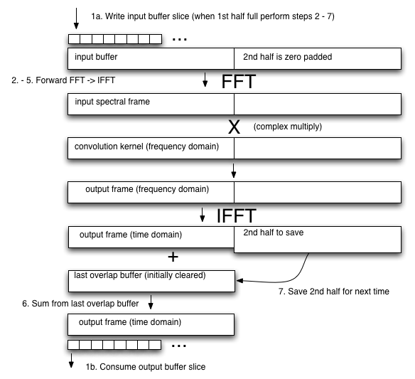
One block convolution
Input buffer zeros
FFT
Input spectral frame
IFFT
X
Output spectral frame
Output frame Save 2nd half
Convolution kernel
2N
Complex multiply
FFT
h zeros
N N

Slide 12
Partitioned convolution for real-time artificial reverberation
s
s_{0:N-1}
s_{N:2N-1}
s_{2N:3N-1}
s_{3N:4N-1}
…
h
h
h
h
…
Convolve impulse response and the current block
{
…
s_{N:2N-1}*h
s_{3N:4N-1}*h
…
s_{0:N-1}*h
s_{2N:3N-1}*h
…
Sum end of previous convolution and beginning of current convolution
{
…
r
…

Slide 13
Buffer[0]
Buffer[1]
Buffer[0]
Buffer[1]
Buffer[0]
Buffer[1]
Buffer[2]
Buffer[3]
Notes:
single channel convolution operates on a mono audio input, using a mono impulse response, and generating a mono output.
The remaining images illustrate the cases for mono and stereo playback where the number of input channels is 1 or 2, and the number of channels in the buffer is 1, 2, or 4. If you want other matrixing options, you can use the ChannelSplitterNode, multiple single-channel ConvolverNodes and then a ChannelMergerNode.
2->4
1->4

Slide 14
Microphone
Source

